Slide 1

INSTITUTE :UIE
DEPARTMENT: ALL ACADEMIC UNITS
Bachelor of Engineering (All Sections)
Subject Name and Code:
Engineering Physics 23SPH-141
Prepared by: Harmanpreet Kaur, Assistant Prof. Physics
UNIT 2
CRYSTALLOGRAPHY & ULTRASONICS
DISCOVER . LEARN . EMPOWER

Slide 2
Course Objectives
The course is designed to make the students industry ready to contribute in the growing demand of the industry at local, national and international level.
It will make the students competent to understand basic concepts and applications of advanced engineering physics and apply its principles in their respective fields at global platform.
It will enhance the skill level of the students and shall make them preferred choice for getting employment in industry and research labs.
It will give thorough knowledge of the discipline to enable students to disseminate knowledge in pursuing excellence in academic areas.

Slide 3
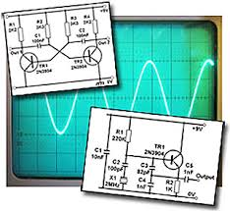
Course Outcomes
CO Number | Title On completion of this course, the students are expected to learn | Level
CO1 | Quote the basic fundamental concepts of lasers, optical fibres, crystallography, ultrasonic oscillations, semiconductor physics, quantum mechanics and nanotechnology. | Remember, Understand
CO2 | Demonstrate the working of various lasers, fibre components, semiconductor devices; explain the behaviour of crystalline solids, quantum and nano-scale systems. | Understand
CO3 | Solve problems by applying principles related to lasers, fibres, semiconductors, oscillations, quantum and nanoscience. | Applying
CO4 | Compare various lasers and fibres, semiconducting devices, crystalline materials, structures at quantum and nanoscale on the basis of their properties for industrial applications. | Analyze
CO5 | Develop various systems using lasers, fibres, semiconductors and nanomaterials for futuristic applications. | Design

Slide 4
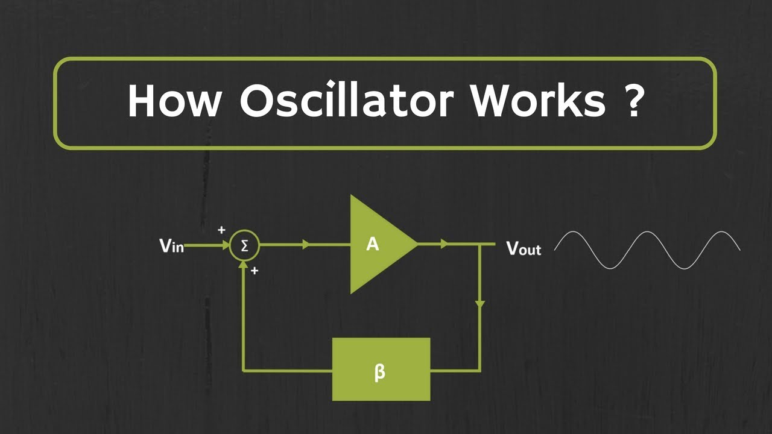
CONTENT TO BE DISCUSSED….
Forced Oscillator with examples.
Figure 1 Working of oscillator [1]

Slide 5
Forced Oscillator
We have seen that the mechanical energy of a damped oscillator decreases in time as a result of the resistive force. It is possible to compensate for this energy decrease by applying a periodic external force that does positive work on the system. At any instant, energy can be transferred into the system by an applied force that acts in the direction of motion of the oscillator. For example, a child on a swing can be kept in motion by appropriately timed “pushes.” The amplitude of motion remains constant if the energy input per cycle of motion exactly equals the decrease in mechanical energy in each cycle that results from resistive forces. If an extra periodic force is applied on a damped harmonic oscillator, then the oscillating system is called driven or forced harmonic oscillator, and its oscillations are called forced oscillations.
.

Slide 6


Equation of Forced Oscillator
Differential equation of motion under forced oscillations is
In this case particle will neither oscillate with its free undamped frequency nor with damped angular frequency rather would it be forced to oscillate with angular frequency ωf of applied force.
Fig. 1.2 Mass attached with spring[2]

Slide 7
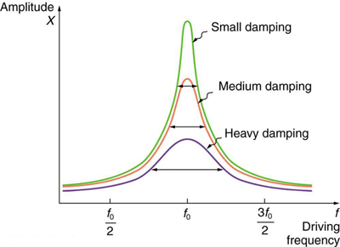
Resonance of Forced Oscillator
The maximum possible amplitude for a given driven frequency is governed by the driving frequency and the damping, and is never infinity.
This phenomenon of increase in amplitude when the driving force is close to natural frequency of oscillator is called RESONANCE
Fig. 3

Slide 8
SUMMARY
It will give thorough knowledge of the Quality factor of Damped Harmonic Oscillator.
It will make the students competent to understand basic concepts of Electrical Oscillator.
Students will learn about the forced oscillations.
How to calculate the Quality Factor of Damped Harmonic Oscillator
Students will study the Various functions of Forced Oscillator

Slide 9
PRACTICE QUESTIONS
How to Calculate Q Value?
A 0.60-kg block attached to a spring with force constant 130 N/m is free to move on a frictionless, horizontal surface as in Active Figure 15.1. The block is released from rest when the spring is stretched 0.13 m. At the instant the block is released, find (a) the force on the block and (b) its acceleration.
What is forced oscillation?
How does the damping affect amplitude in forced oscillation?
A pendulum with a length of 1.00 m is released from an initial angle of 15.08. After 1 000 s, its amplitude has been reduced by friction to 5.508. What is the value of b/2m?
A coil of inductance 5 mH and resistance 10 Ω is connected in parallel with a 250 nF capacitor across a 50 V variable-frequency supply. Determine the Quality Factor.
.

Slide 10
REFERENCES
Books:
Waves and vibrations George C. King School of Physics & Astronomy, The University of Manchester, Manchester, UK ISBN 978-0-470-01188-1 – ISBN 978-0-470-01189-8
Physics for Scientists and Engineers, Eighth Edition SERWAY/ JEWETT ISBN-13: 978-1-4390-4844-3 ISBN-10: 1-4390-4844-4
Web Links:
[1] https://www.youtube.com/watch?v=XVS8Puf4tiw
[2] http://hyperphysics.phy-astr.gsu.edu/hbase/oscdr2.html
[3] courses.lumenlearning.com/physics/chapter/16-8-forced-oscillations-and-resonance/
[4] https://en.wikipedia.org/wiki/Electronic_oscillator

Slide 11
REFERENCES
E Books:
https://www.amazon.in/Engineering-Physics-D-K-Bhattacharya/dp/0199452814
https://www.amazon.in/Physics-Semiconductor-Devices-Simon-Sze/dp/0471143235
Video Links:
https://www.youtube.com/watch?v=vkR2KETqDBI
https://www.youtube.com/watch?v=hEYPjfYslLw&t=45s

Slide 12
THANK YOU
For queries
Email:harmanpreet.uis@cumail.in

